Slide 1



Querying Probabilistic Preferences in Databases
Batya Kenig | Benny Kimelfeld | Julia Stoyanovich | Haoyue Ping
Technion | Technion | Drexel University | Drexel University
Notes:
Vast amounts of preference data are collected and analyzed in a variety of domains. For example, preference data that is generated from consumer sites is used to form recommendations, and preference data extracted from polls is used for predicting election outcomes.
In its most general form preference data appears as a set of arbitrary pairwise preferences or arbitrary partial orders
In this work we set out to develop a preference-centric DB for the management and analysis of preference data

Slide 2



Examples of Preference Data Analysis
Preference Data: pairwise preferences, total, partial, score based, …
Votes
Prioritized gene lists
Product feedback
Route preferences
Analysis: relational manipulation, statistics, mining, aggregation, …
Poll analysis for forecasting
Socio-demographic factors
  [Gormley&Murphy08, McElroy&Marsh08]
Genomic data analysis
Aggregation of empirical results
  [Kolde&al.12, Boulesteix&Slawski09]
Recommendation in e-commerce (e.g., Netflix Challenge, Pandora, …)
Collab. ranking (e.g., Yelp, CNet,…)
Analyze route pref. for cost models
“Stated” & “revealed” preferences
  [Hensher&al.98, Razo&Gao13]
Notes:
Vast amounts of preference data are collected and analyzed in a variety of domains. For example, preference data that is generated from consumer sites is used to form recommendations, and preference data extracted from polls is used for predicting election outcomes.
In its most general form preference data appears as a set of arbitrary pairwise preferences or arbitrary partial orders
In this work we set out to develop a preference-centric DB for the management and analysis of preference data

Slide 3

Preference-centric DB [Jacob, Kimelfeld, Stoyanovich VLDB 2014]
Goal: Framework & principles for a general-purpose system for managing and analyzing preference data
Ordinary Relations
Preference Relations
Foodies
income | age | SSN
Represents a complete/partial ranking
same arity
Opinions
Restaurants
sID
lID
rID
price | cuisine | rID
session
left item
right item
Surveys
Preferred
L-item $≻$ R-item
SSN | sID
Notes:
In a past vision paper we introduced Preference-centric DBs with the goal of developing framework and principles for a general-purpose system for managing and analyzing preference data.
The strategy is to adapt and extend the relational model with notions of preference data and primitive analysis operations.
In this paper we introduce Preference relations that enable storing preferences (left item is preferred to right item), and complete rankings. Every session represents a set of preferences attributed to a judge that represents a customer or voter.

Slide 4
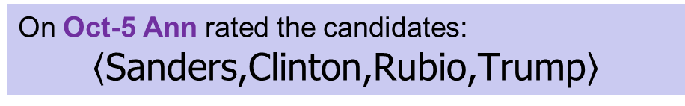
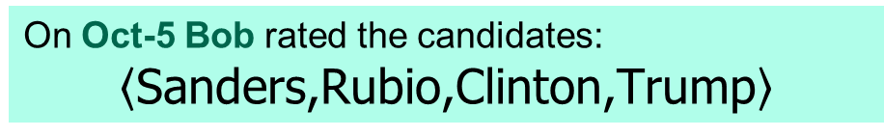
Example of Preference-centric DB
Candidates (o)
edu | sex | party | cand
BS | M | R | Trump
JD | F | D | Clinton
BS | M | D | Sanders
JD | M | R | Rubio
On Oct-5 Ann rated the candidates:
$$\left\langle \text{Sanders}\text{,}\text{Clinton}\text{,}\text{Rubio}\text{,}\text{Trump}\right\rangle$$
Voters (o)
age | sex | edu | voter
25 | F | BS | Ann
35 | M | BS | Bob
40 | F | MS | Cat
45 | M | MS | Dave
55 | F | BS | Eve
35 | M | JD | Fred
On Oct-5 Bob rated the candidates:
$$\left\langle \text{Sanders}\text{,}\text{Rubio}\text{,}\text{Clinton}\text{,}\text{Trump}\right\rangle$$
Notes:
Candidates: Information about political candidates
Voters: information on individual voters
We will show how these rankings are represented in the preference relation

Slide 5
Schemas with Preference Relations
Session signature
LHS
RHS
Candidates (o)
Polls (p)
edu | sex | party | cand
BS | M | R | Trump
JD | F | D | Clinton
BS | M | D | Sanders
JD | M | R | Rubio
rcand | lcand | date | voter
Clinton | Sanders | Oct-5 | Ann
Rubio | Sanders | Oct-5 | Ann
Trump | Sanders | Oct-5 | Ann
Rubio | Clinton | Oct-5 | Ann
Trump | Clinton | Oct-5 | Ann
Trump | Rubio | Oct-5 | Ann
Rubio | Sanders | Oct-5 | Bob
Clinton | Sanders | Oct-5 | Bob
Trump | Sanders | Oct-5 | Bob
Clinton | Rubio | Oct-5 | Bob
Trump | Rubio | Oct-5 | Bob
Trump | Clinton | Oct-5 | Bob
Voters (o)
Sessions
age | sex | edu | voter
25 | F | BS | Ann
35 | M | BS | Bob
40 | F | MS | Cat
45 | M | MS | Dave
55 | F | BS | Eve
35 | M | JD | Fred
[Jacob, Kimelfeld, Stoyanovich VLDB 2014]
Notes:
In a past vision paper we introduced preference-centric DBs, and in particular the preference relation that stores a collection of preferences attributed to a set of judges (customers, voters etc.)
The preferences attributed to a specific judge are identified by a session represented by the set of values in the session signature.

Slide 6
User Preferences are Uncertain
Majority of preference data comes in the form of arbitrary pairwise preferences → missing values (preferences)
User rankings inherently uncertain
Probabilistic models for rankings
  Thurstone (1927), Mallows (1957), Plackett-Luce (1975), Lebanon-Mao (2008)
Considerable work in ML, AI and statistics
  Lu & Boutilier ‘14,
  Huang & Guestrin ’12
  Meila & Meek ’14
  Choi, Van Den Broeck, Darwiche ’15
  Lukasiewicz, Martinez, Poole, Simari ‘16
Notes:
Given the underlying correspondence between rankings and permutations, considerable work in machine learning and AI has exploited probabilistic models on permutations, many of which originate in statistics and psychology.
Lu&Boutilier: Learn Mallows parameters from pairwise preferences
Huang&Guestrin + Meila&Meek
Propose probabilistic models for ranking labeled items or ranking of items from different sets. - has commonality with our work
The work of Choi net. al and Lukasiewicz et. al study ways in which ranking distributions can be represented and reasoned with efficiently.

Slide 7
Goal: Probabilistic Preference-centric DBs
A preference-centric database for managing uncertain data
Use the paradigm of probabilistic databases
Notes:
This work is about a framework for managing uncertain preference data.
We adopt the probabilistic database paradigm in which the database represents a probability distribution over a set of possible worlds. This means that query results are, accordingly, probabilistic.

Slide 8


Probabilistic Databases
Ordinary DB
Data
Query
Outcome
MYSTIQ
pc-tables
TRIO
PrXML
Query
Probabilistic DB
Probabilistic Outcome
Probabilistic Data
When evaluating a query Q over a prob. database, each answer has a probability (confidence)
Pr
Pr(a) = Pr( )
a ∈Q ( )
a is obtained when applying Q to a random database

Slide 9
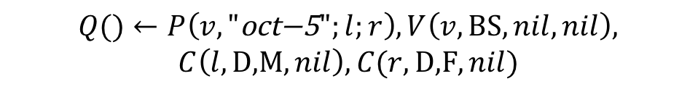





Probabilistic Preferences
Does any voter with a BS degree prefer a Male to a Female democratic candidate ?
Candidates (o)
$$Q()←P\left(v,\text{"}\text{oct}\text{−5}";l;r\right),V\left(v,\text{BS},nil,nil\right),$$
$$C\left(l,\text{D}\text{,}\text{M},nil\right),C(r,\text{D}\text{,}\text{F},nil)$$
edu | sex | party | cand
BS | M | R | Trump
JD | F | D | Clinton
BS | M | D | Sanders
JD | M | R | Rubio
Polls (p)
rcand | lcand | date | voter
Clinton | Sanders | Oct-5 | Ann
Rubio | Sanders | Oct-5 | Ann
Trump | Sanders | Oct-5 | Ann
Rubio | Clinton | Oct-5 | Ann
Trump | Clinton | Oct-5 | Ann
Trump | Rubio | Oct-5 | Ann
Rubio | Sanders | Oct-5 | Bob
Clinton | Sanders | Oct-5 | Bob
Trump | Sanders | Oct-5 | Bob
Clinton | Rubio | Oct-5 | Bob
Trump | Rubio | Oct-5 | Bob
Trump | Clinton | Oct-5 | Bob
$${ I}_{1}$$
$$Pr⁡(I_{1})$$
$$+ Pr⁡(I_{3})$$
Voters (o)
$${ I}_{2}$$
rcand | lcand | date | voter
Rubio | Clinton | Oct-5 | Bob
Sanders | Clinton | Oct-5 | Bob
Trump | Clinton | Oct-5 | Bob
Sanders | Rubio | Oct-5 | Bob
Trump | Rubio | Oct-5 | Bob
Trump | Sanders | Oct-5 | Bob
age | sex | edu | voter
25 | F | BS | Ann
35 | M | BS | Bob
40 | F | MS | Cat
45 | M | MS | Dave
55 | F | BS | Eve
35 | M | JD | Fred
rcand | lcand | date | voter
Trump | Rubio | Oct-5 | Bob
Clinton | Rubio | Oct-5 | Bob
Sanders | Rubio | Oct-5 | Bob
Clinton | Sanders | Oct-5 | Bob
Trump | Sanders | Oct-5 | Bob
Trump | Clinton | Oct-5 | Bob
$${ I}_{3}$$
Notes:
Note that the query is agnostic to the underlying probabilistic model

Slide 10
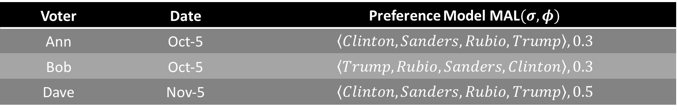
Probabilistic Preference Databases
Preference Model $\text{MAL}(σ,φ)$ | Date | Voter
$$\left\langle Clinton,Sanders,Rubio,Trump\right\rangle , 0.3$$ | Oct-5 | Ann
$$\left\langle Trump,Rubio,Sanders,Clinton\right\rangle , 0.3$$ | Oct-5 | Bob
$$\left\langle Clinton,Sanders,Rubio,Trump\right\rangle , 0.5$$ | Nov-5 | Dave
Polls (p)
rcand | lcand | date | voter
Clinton | Sanders | Oct-5 | Ann
Rubio | Sanders | Oct-5 | Ann
Trump | Sanders | Oct-5 | Ann
Rubio | Clinton | Oct-5 | Ann
Trump | Clinton | Oct-5 | Ann
Trump | Rubio | Oct-5 | Ann
rcand | lcand | date | voter
Clinton | Sanders | Oct-5 | Ann
Rubio | Sanders | Oct-5 | Ann
Trump | Sanders | Oct-5 | Ann
Rubio | Clinton | Oct-5 | Ann
Trump | Clinton | Oct-5 | Ann
Trump | Rubio | Oct-5 | Ann
rcand | lcand | date | voter
Sanders | Clinton | Oct-5 | Ann
Rubio | Clinton | Oct-5 | Ann
Trump | Clinton | Oct-5 | Ann
Rubio | Sanders | Oct-5 | Ann
Trump | Sanders | Oct-5 | Ann
Trump | Rubio | Oct-5 | Ann
rcand | lcand | date | voter
Clinton | Sanders | Oct-5 | Ann
Rubio | Sanders | Oct-5 | Ann
Trump | Sanders | Oct-5 | Ann
Rubio | Clinton | Oct-5 | Ann
Trump | Clinton | Oct-5 | Ann
Trump | Rubio | Oct-5 | Ann
Rubio | Sanders | Oct-5 | Bob
Clinton | Sanders | Oct-5 | Bob
Trump | Sanders | Oct-5 | Bob
Clinton | Rubio | Oct-5 | Bob
Trump | Rubio | Oct-5 | Bob
Trump | Clinton | Oct-5 | Bob
Rubio | Sanders | Oct-5 | Bob
Clinton | Sanders | Oct-5 | Bob
Trump | Sanders | Oct-5 | Bob
Clinton | Rubio | Oct-5 | Bob
Trump | Rubio | Oct-5 | Bob
Trump | Clinton | Oct-5 | Bob
Rubio | Sanders | Oct-5 | Bob
Clinton | Sanders | Oct-5 | Bob
Trump | Sanders | Oct-5 | Bob
Clinton | Rubio | Oct-5 | Bob
Trump | Rubio | Oct-5 | Bob
Trump | Clinton | Oct-5 | Bob
Rubio | Sanders | Oct-5 | Bob
Clinton | Sanders | Oct-5 | Bob
Trump | Sanders | Oct-5 | Bob
Clinton | Rubio | Oct-5 | Bob
Trump | Rubio | Oct-5 | Bob
Trump | Clinton | Oct-5 | Bob
Notes:
Each session is mapped to its own model.
Our inference algorithm operates over RIM models that can be compactly represented using parameters.

Slide 11
Agenda
Introduction
  Ubiquity of preference data
  Preference data inherently uncertain
Framework
  Incorporate preferences under the paradigm of probabilistic DBs
  Decouple the database schema (preference relations) from the internal representation (preference models e.g., Mallows)
Framework instantiation by RIM (Repeated Insertion Model)

Slide 12
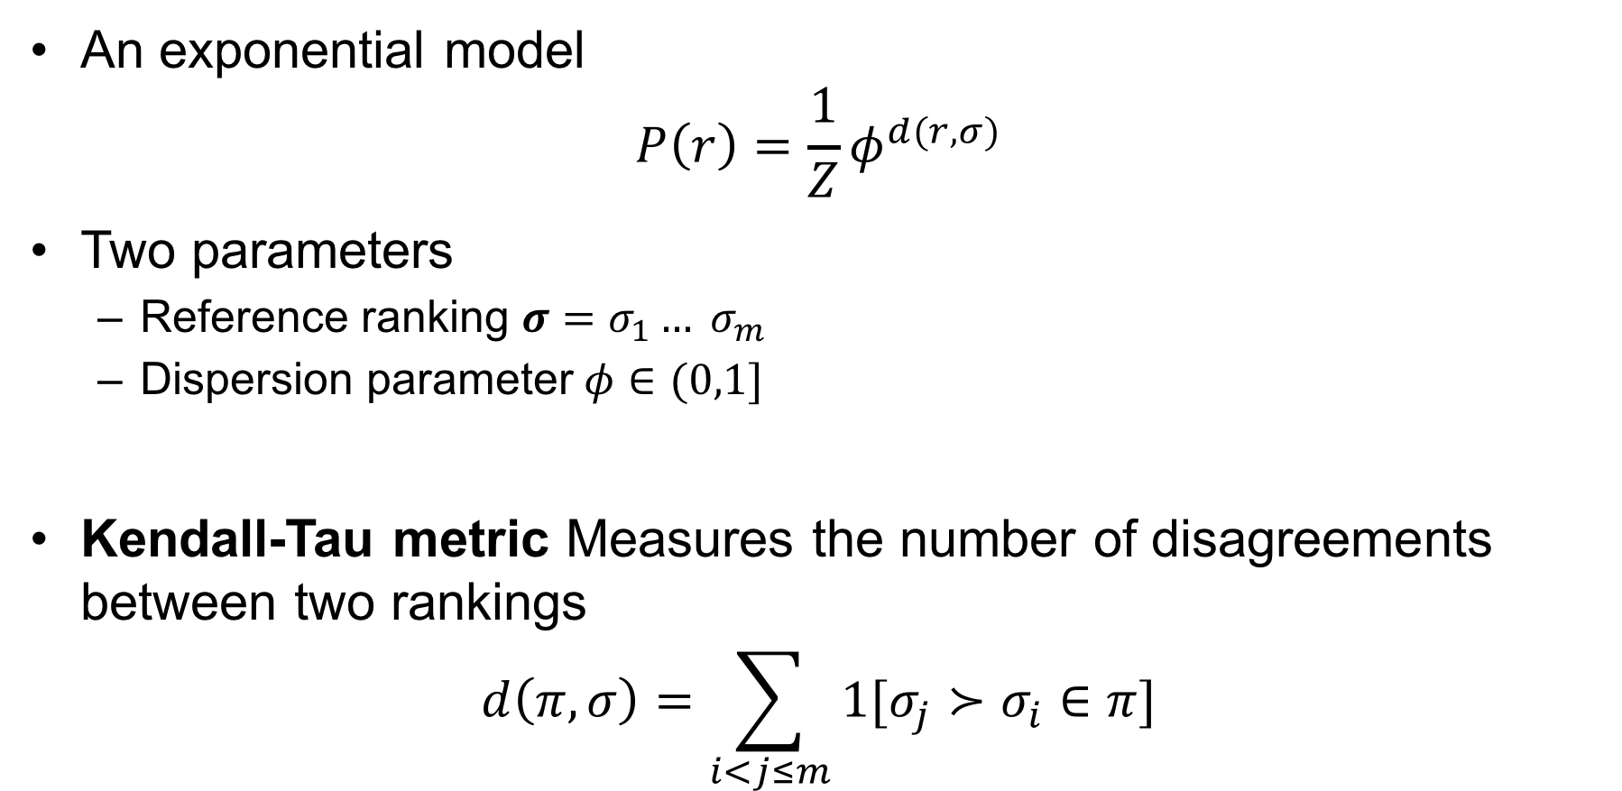
Mallows Distribution [Mallows ‘57]
An exponential model
$$P\left(r\right)=\frac{1}{Z}φ^{d(r,σ)}$$
Two parameters
  Reference ranking $σ=σ_{1}… σ_{m}$
  Dispersion parameter $φ∈(0,1]$
Kendall-Tau metric Measures the number of disagreements between two rankings
$$d\left(π,σ\right)=\sum_{i<j≤m}{1[σ_{j}≻σ_{i}∈π]}$$

Slide 13
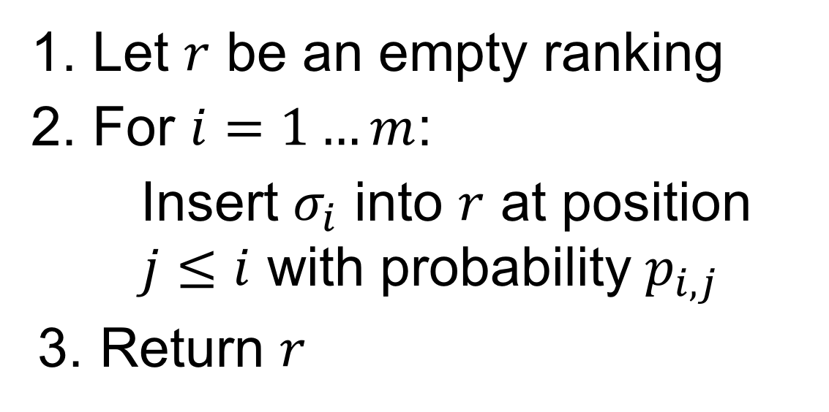
The Repeated Insertion Model (RIM) [Doignon et al., ‘04]
Let $r$ be an empty ranking
For $i=1…m$:
        Insert $σ_{i}$ into $r$ at position $j≤i$ with probability $p_{i,j}$
Return $r$
Notes:
Generative process
Gives rise to a family of distributions over rankings

Slide 14
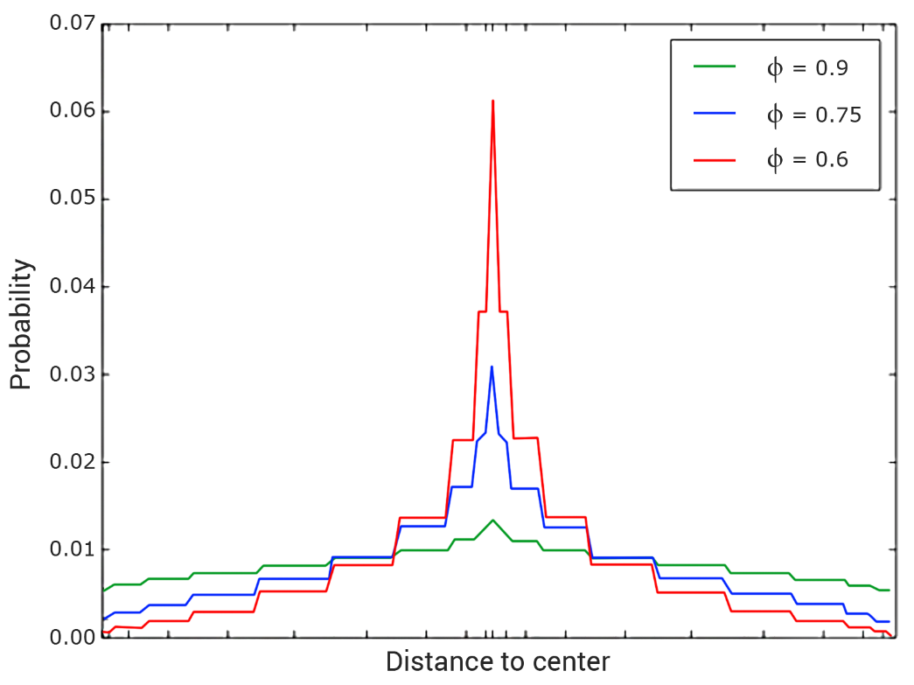
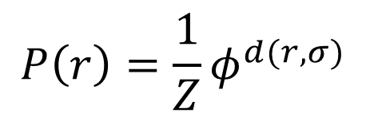
Mallows Distribution
$$P\left(r\right)=\frac{1}{Z}φ^{d(r,σ)}$$

Slide 15









The Repeated Insertion Model (RIM) [Doignon et al., ‘04]
$$1$$
$$2$$
$$3$$
$$4$$
$$5$$
$$6$$
$$7$$
$$8$$
1 | 2 | 3 | 4 | 5 | 6 | 7 | 8
$$\operatorname{Pr}\left(r\right)=p_{1,1}$$

Slide 16



The Repeated Insertion Model (RIM) [Doignon et al., ‘04]
$$2$$
$$3$$
$$4$$
$$5$$
$$6$$
$$7$$
$$8$$
1 | 2 | 3 | 4 | 5 | 6 | 7 | 8
$$1$$
$$\operatorname{Pr}\left(r\right)=p_{1,1}$$
$$×p_{2,2}$$

Slide 17



The Repeated Insertion Model (RIM) [Doignon et al., ‘04]
$$3$$
$$4$$
$$5$$
$$6$$
$$7$$
$$8$$
1 | 2 | 3 | 4 | 5 | 6 | 7 | 8
$$1$$
$$2$$
$$\operatorname{Pr}\left(r\right)=p_{1,1}$$
$$×p_{2,2}$$
$$×p_{3,3}$$

Slide 18










The Repeated Insertion Model (RIM) [Doignon et al., ‘04]
$$4$$
$$5$$
$$6$$
$$7$$
$$8$$
1 | 2 | 3 | 4 | 5 | 6 | 7 | 8
$$1$$
$$2$$
$$3$$
$$\operatorname{Pr}\left(r\right)=p_{1,1}$$
$$×p_{2,2}$$
$$×p_{3,1}$$
$$×p_{4,1}$$

Slide 19











The Repeated Insertion Model (RIM) [Doignon et al., ‘04]
$$5$$
$$6$$
$$7$$
$$8$$
1 | 2 | 3 | 4 | 5 | 6 | 7 | 8
$$4$$
$$1$$
$$2$$
$$3$$
$$\operatorname{Pr}\left(r\right)=p_{1,1}$$
$$×p_{2,2}$$
$$×p_{3,3}$$
$$×p_{4,1}$$
$$×p_{5,1}$$

Slide 20










The Repeated Insertion Model (RIM) [Doignon et al., ‘04]
$$6$$
$$7$$
$$8$$
1 | 2 | 3 | 4 | 5 | 6 | 7 | 8
$$5$$
$$4$$
$$1$$
$$2$$
$$3$$
$$\operatorname{Pr}\left(r\right)=p_{1,1}$$
$$×p_{2,2}$$
$$×p_{3,3}$$
$$×p_{4,1}$$
$$×p_{5,1}$$
$$×p_{6,5}$$

Slide 21









The Repeated Insertion Model (RIM) [Doignon et al., ‘04]
$$7$$
$$8$$
1 | 2 | 3 | 4 | 5 | 6 | 7 | 8
$$5$$
$$4$$
$$1$$
$$2$$
$$6$$
$$3$$
$$\operatorname{Pr}\left(r\right)=p_{1,1}$$
$$×p_{2,2}$$
$$×p_{3,3}$$
$$×p_{4,1}$$
$$×p_{5,1}$$
$$×p_{6,5}$$
$$×p_{7,3}$$

Slide 22








The Repeated Insertion Model (RIM) [Doignon et al., ‘04]
$$8$$
1 | 2 | 3 | 4 | 5 | 6 | 7 | 8
$$5$$
$$4$$
$$7$$
$$1$$
$$2$$
$$6$$
$$3$$
$$\operatorname{Pr}\left(r\right)=p_{1,1}$$
$$×p_{2,2}$$
$$×p_{3,3}$$
$$×p_{4,1}$$
$$×p_{5,1}$$
$$×p_{6,5}$$
$$×p_{7,3}$$
$$×p_{8,4}$$

Slide 23
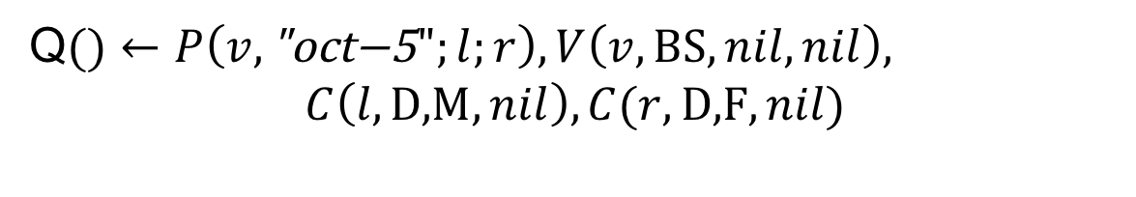
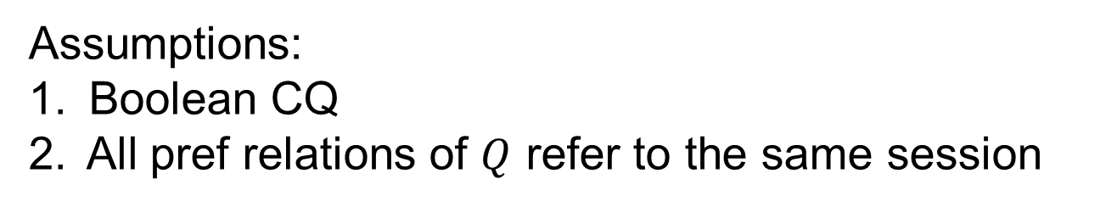
CQ Evaluation on RIM-PPDs
Q$()←P\left(v,\text{"}\text{oct}\text{−5}";l;r\right),V\left(v,\text{BS},nil,nil\right),$
$$C\left(l,\text{D}\text{,}\text{M},nil\right),C(r,\text{D}\text{,}\text{F},nil)$$
Assumptions:
Boolean CQ
All pref relations of $Q$ refer to the same session
Different sessions are
independent
Itemwise CQ: The o-atoms state properties of individual items but do not draw connections between the items
Can be computed in P-time (data complexity)
Notes:
The first candidate atom states that the left item must be a male democrat. The second candidate atom states that the right item must be a female democrat.
No other relationship between the item variables is represented by the ordinary relations.

Slide 24






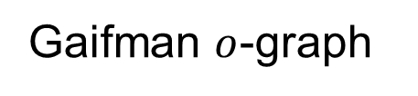
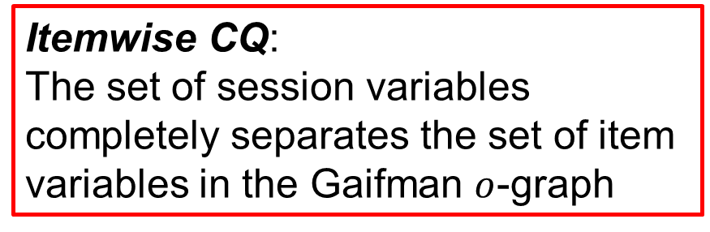







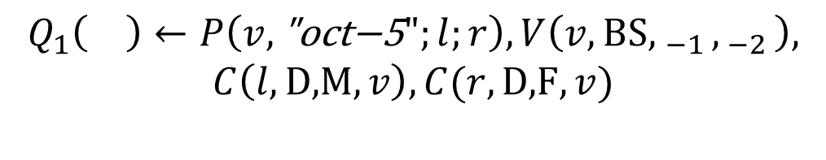





Itemwise CQs - graphically
$$P($$
$$v,d$$
$$)$$
$$;l;r$$
Session
Variables
Item
Variables
$$Q_{1}\left(\right)←P\left(v,\text{"}\text{oct}\text{−5}";l;r\right),V\left(v,\text{BS}{, }_{−1},_{ −2}\right),$$
$$C\left(l,\text{D}\text{,}\text{M},v\right),C(r,\text{D}\text{,}\text{F},v)$$
$$−1$$
Session variable completely separates the item variables
$$−2$$
$$−2$$
$$−1$$
$$−3$$
$$−2$$
$$−2$$
$$−3$$
$$v$$
$$v$$
Itemwise CQ:
The set of session variables completely separates the set of item variables in the Gaifman $o$-graph
$$l$$
$$r$$
$$l$$
$$r$$
Gaifman graph
Gaifman $o$-graph
Notes:
In an itemwise CQ with a constant session, the o-atoms state properties of individual items but do not draw connections between the items.

Slide 25
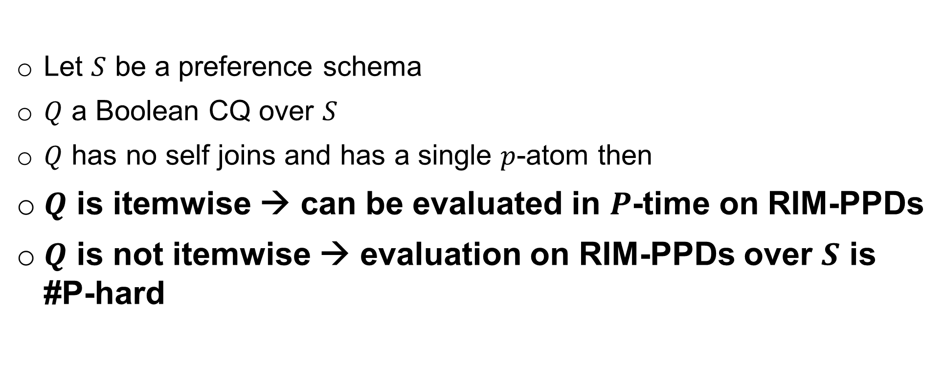
Dichotomy
Let $S$ be a preference schema
$Q$ a Boolean CQ over $S$
$Q$ has no self joins and has a single $p$-atom then
$Q$ is itemwise → can be evaluated in $P$-time on RIM-PPDs
$Q$ is not itemwise → evaluation on RIM-PPDs over $S$ is #P-hard
Notes:
Restricted, yet natural class

Slide 26
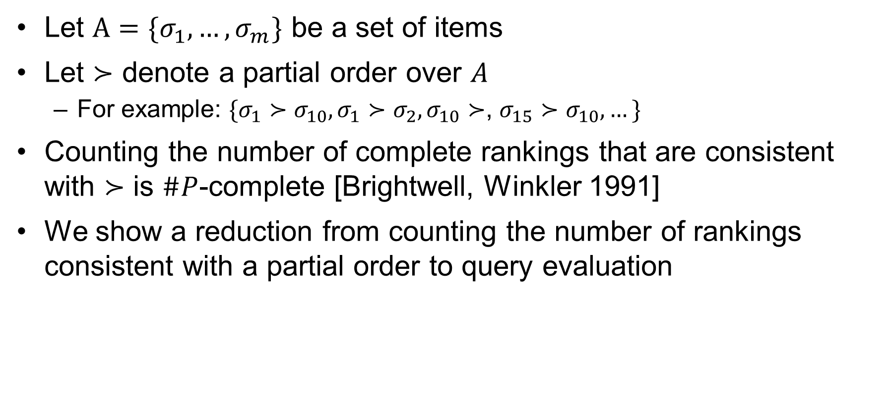
Hardness
Let $A=\{σ_{1},…,σ_{m}\}$ be a set of items
Let $≻$ denote a partial order over $A$
  For example: $\{σ_{1}≻σ_{10}, σ_{1}≻σ_{2}, σ_{10}≻$, $σ_{15}≻σ_{10},…\}$
Counting the number of complete rankings that are consistent with $≻$ is $\#P$-complete [Brightwell, Winkler 1991]
We show a reduction from counting the number of rankings consistent with a partial order to query evaluation
Notes:
We reduce query evaluation to computing the number of rankings that are consistent with the partial order succ

Slide 27



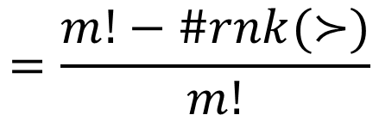


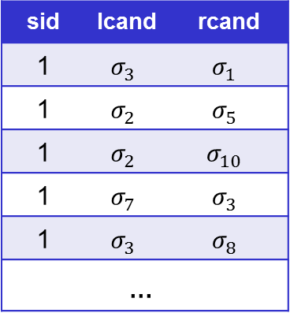


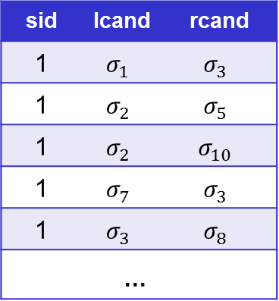

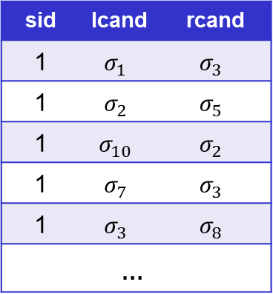



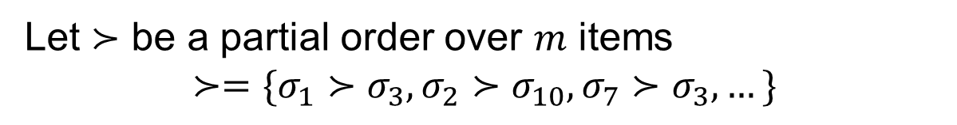
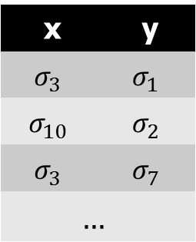

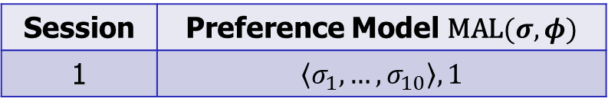
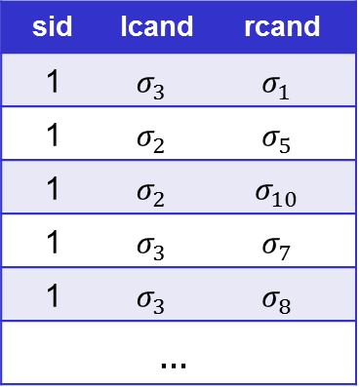
Hardness
$$Q_{h}←R\left(x,y\right),P(x;y)$$
$$R$$
Let $≻$ be a partial order over $m$ items
$$≻=\{σ_{1}≻σ_{3},σ_{2}≻σ_{10},σ_{7}≻σ_{3},…\}$$
y | x
$$σ_{1}$$ | $$σ_{3}$$
$$σ_{2}$$ | $$σ_{10}$$
$$σ_{7}$$ | $$σ_{3}$$
$$…$$
$$P(x;y)$$
rcand | lcand | sid
$$σ_{1}$$ | $$σ_{3}$$ | 1
$$σ_{5}$$ | $$σ_{2}$$ | 1
$$σ_{10}$$ | $$σ_{2}$$ | 1
$$σ_{7}$$ | $$σ_{3}$$ | 1
$$σ_{8}$$ | $$σ_{3}$$ | 1
$$…$$
$$I_{1}$$
rcand | lcand | sid
$$σ_{1}$$ | $$σ_{3}$$ | 1
$$σ_{5}$$ | $$σ_{2}$$ | 1
$$σ_{10}$$ | $$σ_{2}$$ | 1
$$σ_{3}$$ | $$σ_{7}$$ | 1
$$σ_{8}$$ | $$σ_{3}$$ | 1
$$…$$
$$I_{2}$$
$$\text{If} σ_{i}≻σ_{j} \text{then} \text{insert} \text{tuple} \left(σ_{j},σ_{i}\right) \text{into} R$$
rcand | lcand | sid
$$σ_{3}$$ | $$σ_{1}$$ | 1
$$σ_{5}$$ | $$σ_{2}$$ | 1
$$σ_{10}$$ | $$σ_{2}$$ | 1
$$σ_{3}$$ | $$σ_{7}$$ | 1
$$σ_{8}$$ | $$σ_{3}$$ | 1
$$…$$
$$I_{3}$$
rcand | lcand | sid
$$σ_{3}$$ | $$σ_{1}$$ | 1
$$σ_{5}$$ | $$σ_{2}$$ | 1
$$σ_{2}$$ | $$σ_{10}$$ | 1
$$σ_{3}$$ | $$σ_{7}$$ | 1
$$σ_{8}$$ | $$σ_{3}$$ | 1
$$…$$
$$I_{4}$$
Preference Model $\text{MAL}(σ,φ)$ | Session
$$\left\langle σ_{1},…,σ_{10}\right\rangle , 1$$ | 1
$$\operatorname{Pr}\left(Q\left[D\right]\right)=$$
$$\operatorname{Pr}\left(I_{1}\right)$$
$$+ Pr\left(I_{2}\right)$$
$$+ Pr\left(I_{4}\right)$$
$$+…$$
$$=\frac{m!−\#rnk(≻)}{m!}$$

Slide 28
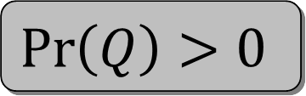
Itemwise CQ Evaluation
Labeled pattern
matching
CQ Evaluation
The set of pattern-consistent
rankings is nonempty
$$\operatorname{Pr}\left(Q\right)>0$$
Notes:
We translate the CQ evaluation problem into one of labeled pattern matching in graphs.
The translation is performed in a way such that every database instance that returns a nonempty answer for the query, represents a database instance (that is, a ranking), which is consistent with the pattern.
We show later that this equivalence is precisely the source of hardness for non-itemwise queries.

Slide 29







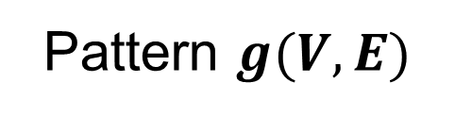
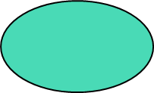
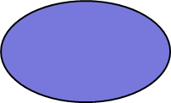
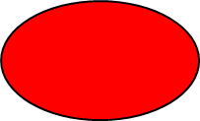
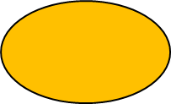



Patterns
Items
$$A=\{1, 2, 3, 4, 5, 6, 7, 8\}$$
Pattern $g(V,E)$
$$1$$
$$4$$
$$3$$
$$8$$
Every item is mapped to a subset of labels (nodes)
Edges represent precedence constraints
$$5$$
$$7$$
$$2$$
$$2$$
$$6$$

Slide 30

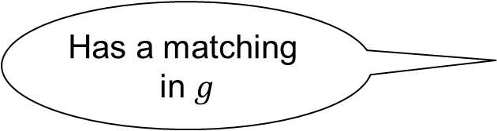



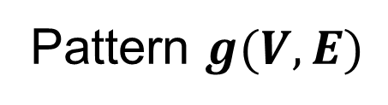


Matchings
Pattern $g(V,E)$
$$r=\left\langle 8, 2, 1, 7, 4, 5, 6, 3\right\rangle$$
$$1$$
$$4$$
$$3$$
$$8$$
A matching of $g$ in $r$:
$$5$$
$$7$$
$$2$$
$$ℳ: V→\text{items}(r)$$
Labels match
Edges match
$$2$$
$$6$$
Factorial in
the size of
the data!
$$\sum_{r⊨g}{\operatorname{Pr}\left(r\right)}$$
Has a matching
in $g$

Slide 31



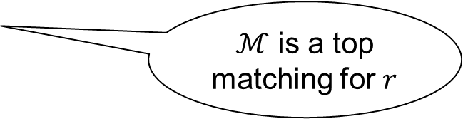









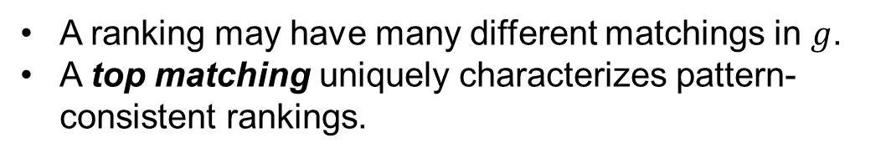
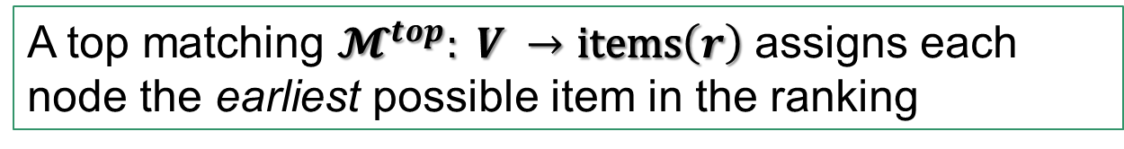
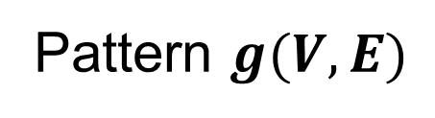

Top Matchings
Pattern $g(V,E)$
A ranking may have many different matchings in $g$.
A top matching uniquely characterizes pattern-consistent rankings.
$$1$$
$$4$$
$$3$$
$$8$$
$$r=\left\langle 8, 2, 1, 7, 4, 5, 6, 3\right\rangle$$
$$5$$
$$7$$
$$2$$
Top matchings partition the space of consistent rankings
A top matching $𝓜^{top}: V →\text{items}\left(r\right)$ assigns each node the earliest possible item in the ranking
$$2$$
$$6$$
$$\sum_{r⊨g}{\operatorname{Pr}\left(r\right)}$$
$$=\sum_{ℳ}{\sum_{r⊨ℳ}{Pr⁡(r)}}$$
$$\operatorname{Pr}\left(Q\right)=$$
$ℳ$ is a top matching for $r$
Notes:
We show in the paper that every consistent ranking has exactly one top matching.
Therefore, the set of top matchings partitions the space of consistent rankings.

Slide 32
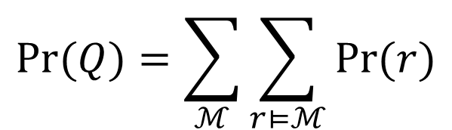
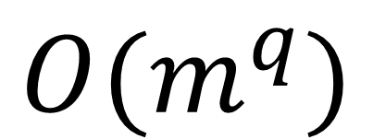
Why is this useful ?
Pattern $g(V,E)$
$$Pr⁡(Q)=\sum_{ℳ}{\sum_{r⊨ℳ}{Pr⁡(r)}}$$
$$1$$
$$4$$
$$3$$
$$8$$
How many top matchings are there ?
$$5$$
$$7$$
$$2$$
Each node can be assigned one of $m$ items
$$O(m^{q})$$
Exponential in the size of the query
$$2$$
$$6$$

Slide 33
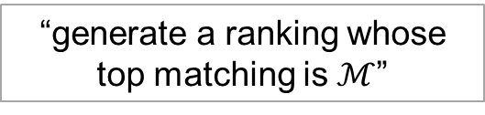

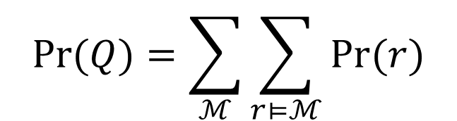
Not done yet…
$$Pr⁡(Q)=\sum_{ℳ}{\sum_{r⊨ℳ}{Pr⁡(r)}}$$
$$=\sum_{ℳ}{Pr⁡(ℳ) }$$
Need to
compute
“generate a ranking whose top matching is $ℳ$”

Slide 34
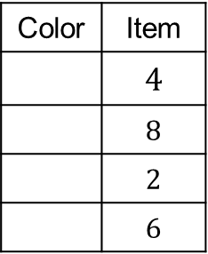

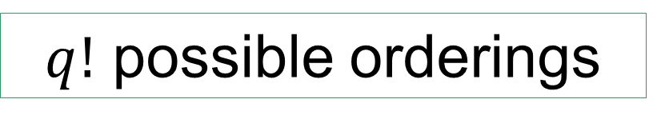

















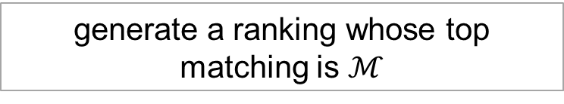


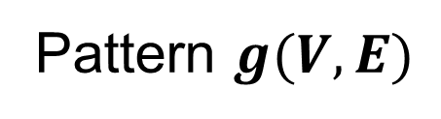
Rank Generation
$$Pr⁡(Q)=\sum_{ℳ}{\sum_{r⊨ℳ}{Pr⁡(r)}}$$
$$=\sum_{ℳ}{Pr⁡(ℳ) }$$
generate a ranking whose top matching is $ℳ$
Pattern $g(V,E)$
Step 1:
Start with some consistent order of the mapped items
$$1$$
$$4$$
$$3$$
$$8$$
$$ℳ$$
Item | Color
$$4$$
$$8$$
$$2$$
$$6$$
$$4$$
$$8$$
$$2$$
$$6$$
$$5$$
$$7$$
$$2$$
$$8$$
$$4$$
$$2$$
$$6$$
$$2$$
$$6$$
$q!$ possible orderings

Slide 35





Step 2 – Generate the Ranking
$$1$$
$$2$$
$$3$$
$$4$$
$$5$$
$$6$$
$$7$$
$$8$$
1 | 2 | 3 | 4 | 5 | 6 | 7 | 8
$$4$$
$$8$$
$$2$$
$$6$$
Not consistent with the top matching!!

Slide 36













Step 2 – Generate the Ranking
$$1$$
$$2$$
$$3$$
$$4$$
$$5$$
$$6$$
$$7$$
$$8$$
1 | 2 | 3 | 4 | 5 | 6 | 7 | 8
$$4$$
$$8$$
$$2$$
$$6$$
$$\operatorname{Pr}\left(r\right)=p_{1,1}$$
??

Slide 37





Step 2 – Generate the Ranking
$$2$$
$$3$$
$$4$$
$$5$$
$$6$$
$$7$$
$$8$$
1 | 2 | 3 | 4 | 5 | 6 | 7 | 8
$$4$$
$$8$$
$$1$$
$$2$$
$$6$$
$$\operatorname{Pr}\left(r\right)=p_{1,1}$$
$$×p_{2,2}$$

Slide 38


Step 2 – Generate the Ranking
$$3$$
$$4$$
$$5$$
$$6$$
$$7$$
$$8$$
1 | 2 | 3 | 4 | 5 | 6 | 7 | 8
$$4$$
$$8$$
$$1$$
$$2$$
$$6$$
Not consistent with the top matching!!
$$\operatorname{Pr}\left(r\right)=p_{1,1}$$
$$×p_{2,2}$$

Slide 39

Step 2 – Generate the Ranking
$$3$$
$$4$$
$$5$$
$$6$$
$$7$$
$$8$$
1 | 2 | 3 | 4 | 5 | 6 | 7 | 8
$$4$$
$$8$$
$$1$$
$$2$$
$$6$$
$$\operatorname{Pr}\left(r\right)=p_{1,1}$$
$$×p_{2,2}$$
$$×p_{3,3}$$

Slide 40










Step 2 – Generate the Ranking
$$4$$
$$5$$
$$6$$
$$7$$
$$8$$
1 | 2 | 3 | 4 | 5 | 6 | 7 | 8
$$4$$
$$8$$
$$1$$
$$2$$
$$6$$
$$3$$
$$\operatorname{Pr}\left(r\right)=p_{1,1}$$
$$×p_{2,2}$$
$$×p_{3,3}$$
$$×p_{4,1}$$

Slide 41















Step 2 – Generate the Ranking
$$5$$
$$6$$
$$7$$
$$8$$
1 | 2 | 3 | 4 | 5 | 6 | 7 | 8
$$4$$
$$8$$
$$1$$
$$2$$
$$6$$
$$3$$
$$\operatorname{Pr}\left(r\right)=p_{1,1}$$
$$×p_{2,2}$$
$$×p_{3,3}$$
$$×p_{4,1}$$
$$×p_{5,1}$$

Slide 42












Step 2 – Generate the Ranking
$$6$$
$$7$$
$$8$$
1 | 2 | 3 | 4 | 5 | 6 | 7 | 8
$$5$$
$$4$$
$$8$$
$$1$$
$$2$$
$$6$$
$$3$$
$$\operatorname{Pr}\left(r\right)=p_{1,1}$$
$$×p_{2,2}$$
$$×p_{3,3}$$
$$×p_{4,1}$$
$$×p_{5,1}$$
$$×p_{6,5}$$

Slide 43















Step 2 – Generate the Ranking
$$7$$
$$8$$
1 | 2 | 3 | 4 | 5 | 6 | 7 | 8
$$5$$
$$4$$
$$8$$
$$1$$
$$2$$
$$6$$
$$3$$
$$\operatorname{Pr}\left(r\right)=p_{1,1}$$
$$×p_{2,2}$$
$$×p_{3,3}$$
$$×p_{4,1}$$
$$×p_{5,1}$$
$$×p_{6,5}$$
$$×p_{7,3}$$

Slide 44















Step 2 – Generate the Ranking
$$8$$
1 | 2 | 3 | 4 | 5 | 6 | 7 | 8
$$5$$
$$4$$
$$7$$
$$8$$
$$1$$
$$2$$
$$6$$
$$3$$
$$\operatorname{Pr}\left(r\right)=p_{1,1}$$
$$×p_{2,2}$$
$$×p_{3,3}$$
$$×p_{4,1}$$
$$×p_{5,1}$$
$$×p_{6,5}$$
$$×p_{7,3}$$
$$×p_{8,4}$$
Classic RIM
probability

Slide 45

Complexity Analysis
Number of top matchings $ℳ$ to compute - $O(m^{q})$
For each top matching there can be $O(q!)$ different complete orders for the mapped items
Calculating the probability of a single top matching
  Dynamic programming
  Number of states $O(m^{q})$
Exponential only in $q$ the size of the query

Slide 46
Future Work
More general query languages
  Negation
  UCQ
Generalize dichotomy in the complexity of CQ
Approximate query evaluation
Tractability conditions under combined complexity (query-and-data)
Develop into a practical system
  Optimization
  Parallelization

Slide 47
Thank You!
Questions?

